Slide 1
Online fraud prediction
By:
Syed Abdallah daimi
Mohammed muzammil khan ghori
GUDA Kirthi koushika

Slide 2
Overview
The data set contains the information of the transactions that is done over the duration of one month.
We have to determine whether the transaction which was done is legitimate or fraudulent
The data set contains the info about the type of transaction ,amount , time of transaction , old and new balance of sender and receiver and whether the transaction is flagged as fraud or not.

Slide 3
Problem Statement
The data set shows the transactions and their parameters.
We have to build a model that can predict whether the transaction is legit or fraud by training the model.
We have to preprocess the data ,visualize the data, balance the data set, build a model and deploy it.

Slide 4
Data preprocessing
In the given data set first we checked if there is any column which we can delete which will not affect the result by deleting it.
So the columns nameorig and namedest was deleted
Then the data was checked whether if there is any imbalance in the dataset for the target column.
There was heavy imbalance in the isFraud column
0 63544077
1 8213

Slide 5
Checking for null values
The data set is checked for any null values present in the columns that should be filled or deleted according to the data.
The null values are checked by using df.isnull().sum()
There is no null values so no need to add or delete the data

Slide 6
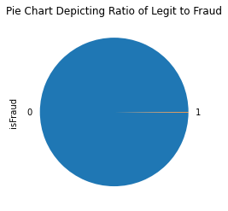
Data Visualization
Data is visualized by importing the matplotlib.pyplot and seaborn library
First the resulting column is visualized weather the transaction was fraud or legitimate i.e., for isFraud col between 0 and 1.
The isFraud column is visualized using a pie chart because it has only 2 numeric resulting values.
Text(0.5, 1.0, 'Pie Chart Depicting Ratio of Legit to Fraud')

Slide 7
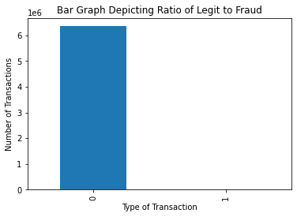
Bar graph representation of legit to fraud
The legit to fraud data ratio is visualize using bar graph by taking type of transaction on x-axis and number of transaction on y-axis

Slide 8
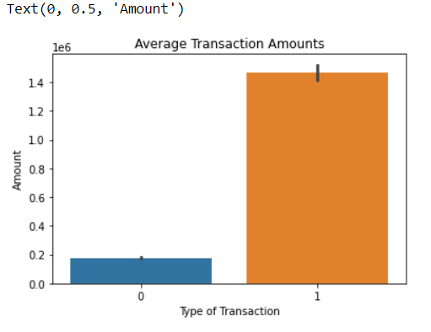
Visualizing the average amount in legitimate and fraudulent transaction
The average transaction amount is visualized between type of transaction i.e., fraud and legit ,and amount .

Slide 9
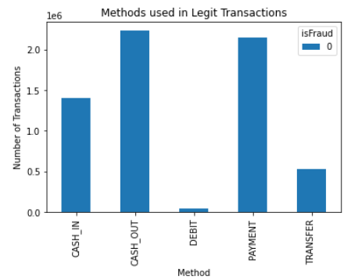
Methods used in Legit Transactions

Slide 10
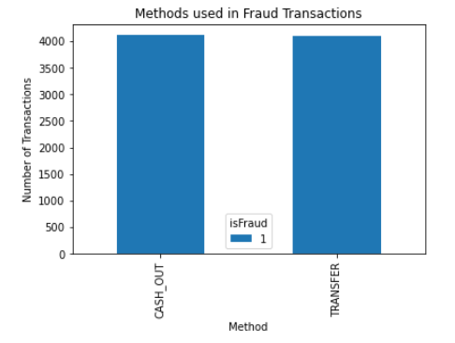
Methods used in Fraud transactions

Slide 11
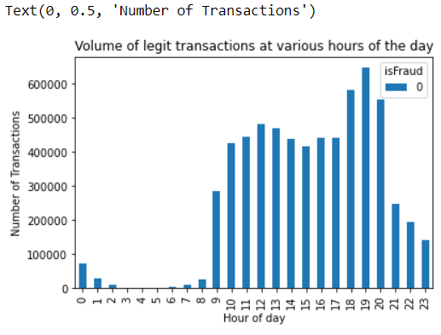
GRAPH SHOWING THE NUMBER OF LEGIT TRANSACTIONS AT VARIOUS HOURS OF THE DAY
This bar graph shows the number of legit transaction throughout the day for 24 hours
The graph is plotted between hours on x-axis and number of transaction in a day on y axis.

Slide 12
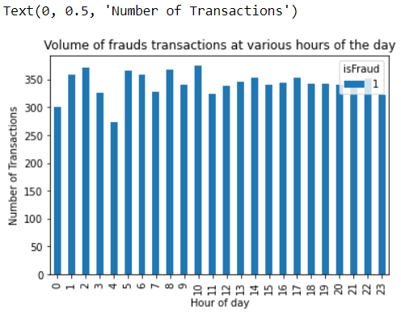
GRAPH SHOWING THE NUMBER OF FRAUDULENT TRANSACTIONS AT VARIOUS HOURS OF THE DAY
This graph shows the number of fraud transactions in a day
The graph is plotted between hours of day on x-axis and number of transaction on y-axis

Slide 13
Fixing Imbalance of Target Class
We have tried 3 methods to fix imbalance
Random Undersampling
Random Oversampling
SMOTE
ADASYN
However all of them are changing the data metrics too much which is causing the precision to drop heavily while training , this is illustrated in the next slide.

Slide 14
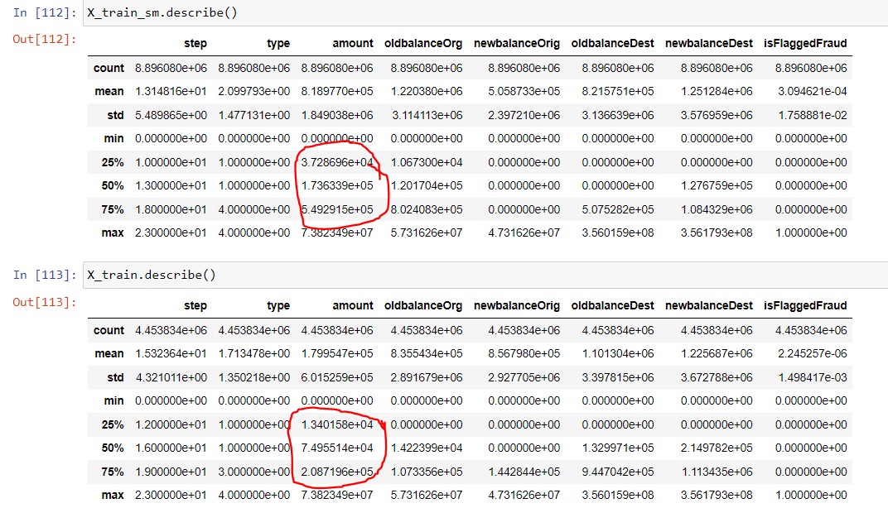
SMOTE shifting the data metrics
This graph shows the number of fraud transactions in a day
The graph is plotted between hours of day on x-axis and number of transaction on y-axis

Slide 15
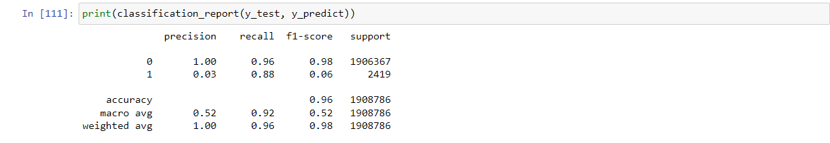
Fixing Imbalance of Target Class
Score with SMOTE
As we can see the precision is very low due to shift in data metrics

Slide 16
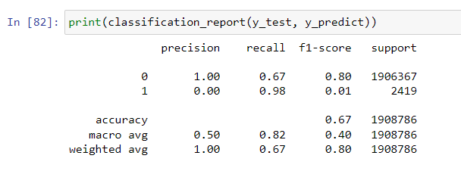
Fixing Imbalance of Target Class
Score with Random Oversampling
As we can see the precision is very low due to shift in data metrics

Slide 17
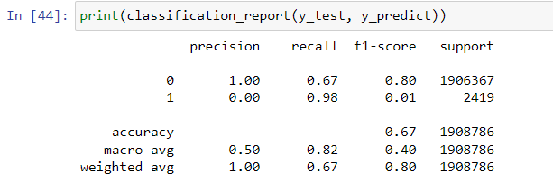
Fixing Imbalance of Target Class
Score with Random Undersampling
As we can see the precision is very low due to shift in data metrics
As a result we have decided to proceed with the original dataset for creating the model.

Slide 18
Selecting Model
We have tried 3 Machine Learning Models
K Nearest Neighbours (KNN Algorithm)
Logistic Regression
XGBoost
Out of these the best baseline score was given by XGBoost so we picked that and performed Hyperparameter tuning on it , the various accuracies and classification reports are highlighted in the following slides

Slide 19
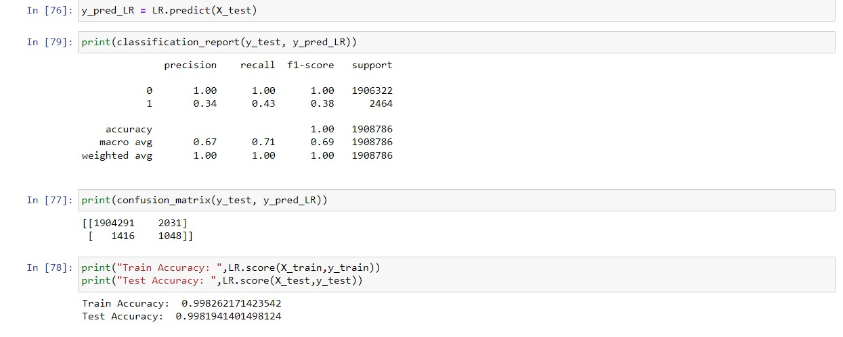
Logistic Regression
Logistic Regression gave a pretty low baseline score so we dropped it

Slide 20
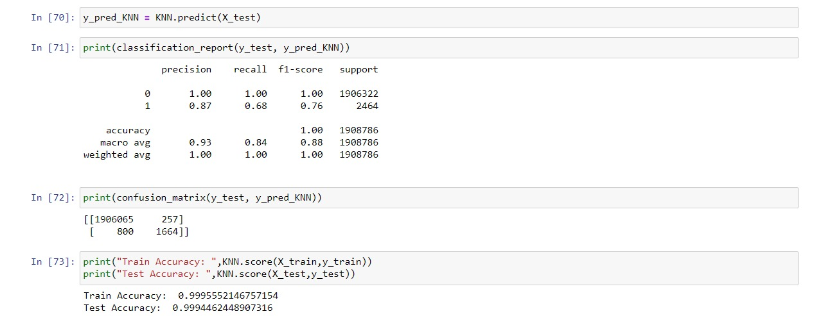
K Nearest Neighbours (KNN)
KNN had a decent baseline f1 score of 76%

Slide 21
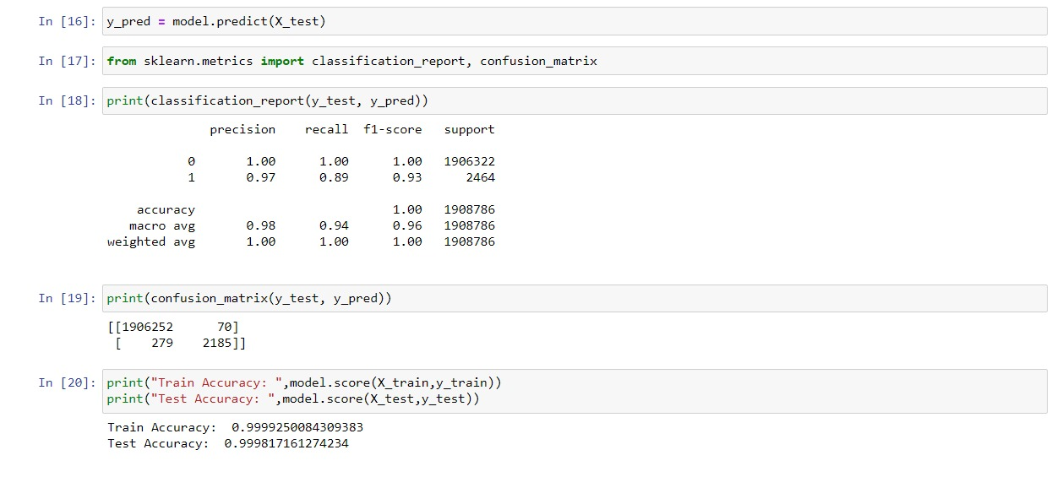
XGBoost
XGBoost gave a baseline F1 Score of 90% and after hyperparameter tuning we were able to bring it up to 93% and proceeded to Deploy the model

Slide 22
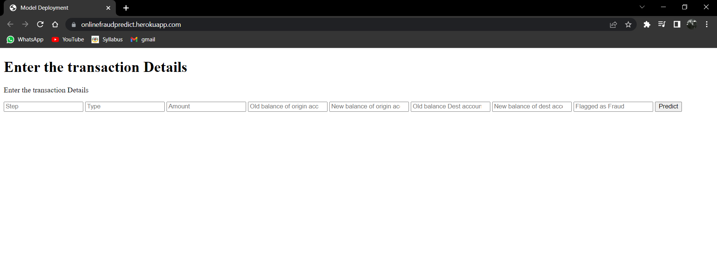
Model deployment using Flask
This is the UI for the model deployment which is being hosted on Heroku platform

Slide 23
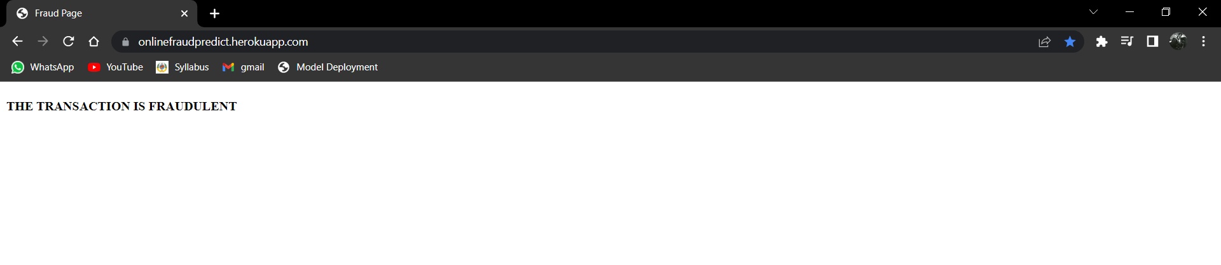
Fraud prediction by model

Slide 24
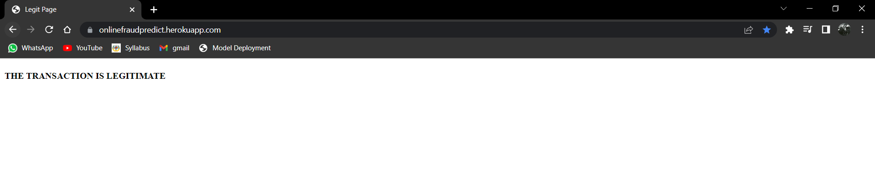
Legit prediction by model

